Slide 1
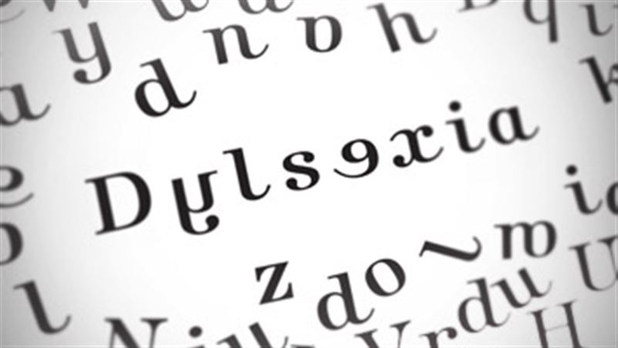
INTELLIGENT SUPPORT SYSTEM FOR PEOPLE WITH LEARNING DISABILITIES

Slide 2
Problem statement

Slide 3
Introduction
Our objective is to develop an Interactive learning application (Android) for children suffering from Dyslexia.
This application should inculcate proper approaches and strategies in order to help the child overcome the challenges faced in reading and writing text.
At the same time, it should be more interactive, for instance, it may have an interface similar to that of a game so that the user (Dyslexic child) won’t get bored.

Slide 4
What is Dyslexia ?
Dyslexia is a specific learning disability in reading. Kids with Dyslexia have trouble reading accurately and fluently.
Dyslexic people may also have trouble with reading comprehension, spelling and writing.
A key sign of Dyslexia in kids is trouble in decoding words. This is the ability to match letters to sounds and then use that skill to read words accurately and fluently.

Slide 5
Motivation
Most of the interactive learning apps for Dyslexic children on Google play-store are not available for free, thus not affordable by all. So, it is important to develop an app (to be available free of cost) for this domain.
Apart from the support given by parents and teachers, these kind of applications will encourage independent reading for students with language related learning disabilities.

Slide 6
Objective
Our objective for this semester was to complete major portion of the backend of the app.
Backend mainly comprises the Natural Language Generation module : Given labelled words (difficulty level), we have to classify into n levels, and the words corresponding to each level should be used to generate sentences of varying types and degrees which will be fed to the user as input.

Slide 7
Challenges
The generated sentences should be grammatically correct
(a) Part of Speech Errors
For eg: Tom cricket play.
Two nouns cannot be used consecutively in a sentence.
(b) Tense Errors
For eg: Tom play cricket.
It should be “Tom plays cricket”
.

Slide 8
Challenges
2. The generated sentences should be meaningful.
For eg: 'Tom eats apple' is meaningful but
'Apple eats tom' is not meaningful.

Slide 9
Datasets

Slide 10
SVO Dataset
Each line in the dataset file consists of the following tab-delimited fields:
Subject
Verb ( +Preposition )
Object
Frequency
Eg : Presentation contains facts 4
Subject : Presentation
Verb : contains
Object : facts
Frequency : 4
This dataset comprises of Subject-Verb-Object (SVO) triplets generated as part of the NELL project of CMU. This dataset has 604 million triplets and the total size of the dataset is 25GB.

Slide 11
Context Dataset
The dataset has 3 files:
Word Nodes
Context Nodes
Word to context edges
We used this dataset to extract the adjectives which in turn, can be used to associate with the corresponding nouns.
This dataset is a mapping of nouns to their context, stored as a bipartite graph.
The words associated with a noun form its context. For eg: Roar, mane, eats and runs are in the context of lion. This dataset has a maximum of 1000 contexts for each noun.

Slide 12
Context Dataset
Each line in word node contains:
Word Name
Word ID
Each line in context node contains:
Context Name
Context ID
Relation of context with the word
Each line in the word to context edges contain:
Word ID
List of the IDs of all connected context words and their weights
This dataset is a mapping of nouns to their context, stored as a bipartite graph.
The words associated with a noun form its context. For eg: Roar, mane, eats and runs are in the context of lion. This dataset has a maximum of 1000 contexts for each noun.

Slide 13
Approach

Slide 14
Initial approach (using CFG)
A Context-Free Grammar is a set of rules that define the syntax of a language i.e. what is and is not a valid sequence of ''tokens''.
We first deduced a CFG (Context-Free Grammar) and generated the sentences with the words present in the vocabulary, using this.
But this approach was not giving satisfactory results - the sentences generated were grammatically correct but not meaningful.
This was expected as the CFG doesn't take care of the context of the sentence.

Slide 15
Modified approach
Using SVO triples and associated adjectives to generate the sentences using the grammar rules.
Subject, verb and object are sufficient to generate simple sentences.
We also extracted adjectives for every noun in the vocabulary from Context dataset.

Slide 16
Filtering of SVO dataset
The SVO dataset has junk data and required filtering.
For first level filtering, we used a threshold of 5 for frequency.
The size of data after this step was 1.1 GB.
Finally, we filtered out all the triples which had words not in our vocabulary.

Slide 17
Generating simple sentences
Input:
Subject = Mary
Object = the monkey
Verb = chase
Output:
Mary chases the monkey.

Slide 18
Changing the tense
Input : Subject = Mary; Object = the monkey; Verb = Chase; Tense = past Output: Mary chased the monkey.
Input : Subject = Mary; Object = the monkey; Verb = Chase; Tense =future Output: Mary will chase the monkey.

Slide 19
Getting negations
Input: Subject = Mary
Object = the monkey
Verb = Chase
Tense = future
Negation = true
Output: Mary will not chase the monkey.

Slide 20
Generating Questions
Yes/No Questions
Input: Subject = Mary, Object = the monkey, Verb = Chase, Tense = future, Question = true
Output: Does Mary chase the monkey?
Wh Questions
Input: Subject = Mary, Verb = Chase, Tense = future, Question = true, Question Type = Who
Output: Who does Mary chase?

Slide 21
Using adjectives
Input : Subject = Mary
Object = the monkey
Verb = chase
Subject adjective = fast
Output : Fast Mary chases the monkey

Slide 22
Results

Slide 23
83% accuracy
Using the second approach (SVO dataset), we generated the sentences of different types - simple, changing tense, negated, questions, adjective associated. By manual inspection over 1000 lines (through random selection) of the final dataset, we have found that 83% of the sentences are grammatically correct and meaningful.

Slide 24
App design

Slide 25
App design
When the user (dyslexic child) opens the app, there will be n levels of difficulty and he/she has to start from level one and unlock the next level once he/she reaches a certain level of accuracy.
With respect to that level (say level x), the corresponding words and associated sentences will be used as input(s) for the writing exercise.
The user is expected to replicate the input on the phone screen and the output given by the user will be recognized and accuracy checking will be done with respect to comparing the input and processed output letter by letter.

Slide 26
App design
If the user output is erroneous and not satisfactory (if the user accuracy is not upto the mark), then the particular word/sentence will be stored separately in another database (say database Dx) and will be fed to the user more frequently in the future till he/she overcomes the difficulty with respect to that word/sentence.
The working of the app will be in such a way that every time when the user selects level x, those words will be fed frequently till the accuracy with respect to the word goes above the threshold accuracy. Once the user reaches that accuracy, that particular word/sentence will be removed from database Dx.

Slide 27
THANK YOU !

